Slide 1
The many guises of an edtech: past, present and future

Slide 2
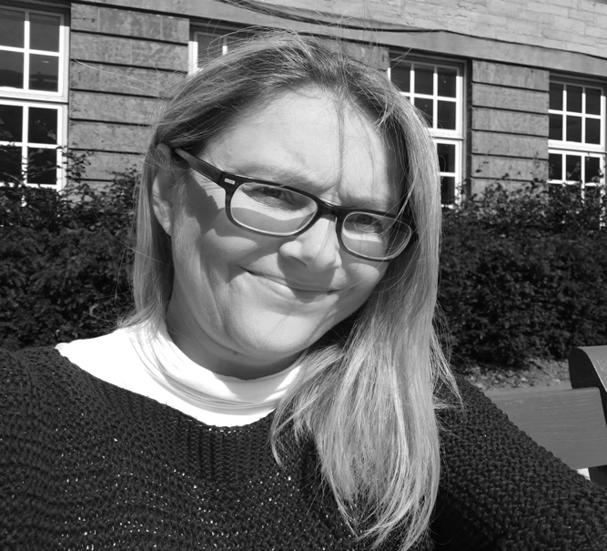
Hello!
I am Clare Thomson
I am here for the craic
You can find me at @slowtech2000 or c.thomson@ulster.ac.uk

Slide 3
Before
The dreaded question:
“So, what do you do?”

Slide 4
Mr benn – had adventures as different people first televised by the BBC in 1971 and 1972.

Slide 5
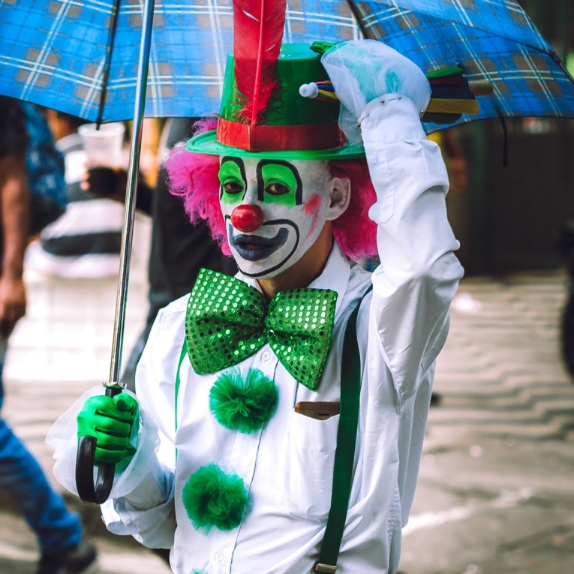
clown
He sees circus folk stopped at a bridge; it had collapsed! The people were fussing over the broken bridge … Mr Benn suggests they work together & they agree. Spirits raised, they begin working on the bridge.
Notes:
Lift spirits/counsellor

Slide 6
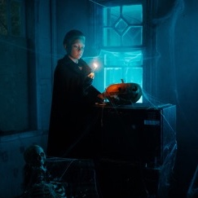
wizard
Mr Benn is asked by a Queen to change her husband's appearance, feeling he is not kingly enough … Mr Benn eventually convinces the Queen that how the King looks is not important.

Slide 7
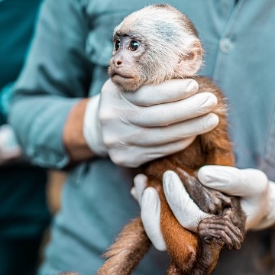
zookeeper
Mr Benn helps the animals in the zoo to improve their accommodation by making the townsfolk see that the cages are too small.

Slide 8
pirate
Mr Benn helps the crew of a pirate ship, who are determined not to be pirates and turn their Captain into an honest man.

Slide 9
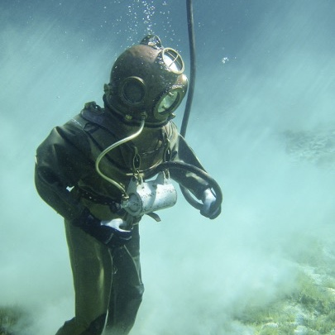
diver
Mr Benn helps King Neptune and his mermaid friend outwit the crews of two submarines, who are out to find and photograph the King's pet sea monster.

Slide 10
The future
Increased levels of professional accreditation such as Advance HE, CMALT
Teaching and research training
Job specs with care, compassion, empathy …….

Slide 11
Made with Powerpoint – nothing but shapes & copyright clear

Slide 12
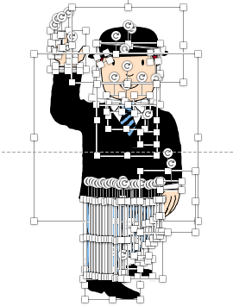
Thank you for listening
Deconstructed Mr Benn!

Slide 13
Credits
Special thanks to all the people who made and released these awesome resources for free:
Presentation template by SlidesCarnival
Photographs by Pexels and Pixabay
Text from Wikipedia, Mr Benn article

